Slide 1

LM Big Data Management in Finance Birmingham Business School Fundamentals of Machine Learning
Dr. Animesh Acharjee

Slide 2
Agenda
What is machine learning
Types of machine learning
Fundamentals of machine learning
Validation matrices
Why penalization methods required?
What is penalization?

Slide 3
What is machine learning
Machine learning, a branch of artificial intelligence, concerns the construction and study of systems that can learn from data (http://en.wikipedia.org/wiki/Machine_learning)
Why we should use machine learning?
Machine learning methods are not based on statistical assumptions such as normality, independence etc.
All machine learning methods are non-parametric but reverse is not always true
Some machine learning algorithms are inspired by biological phenomena. Ex: Genetic algorithm, ant colony optimization

Slide 4
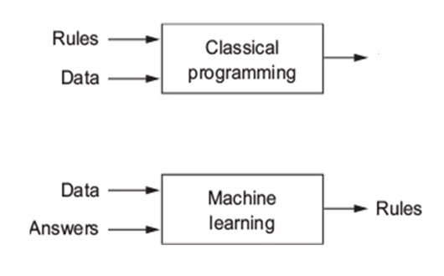

Classical vs. machine learning models
Classical models are presented with rules and data to get answers
Machine learning systems is trained rather explicitly programmed

Slide 5
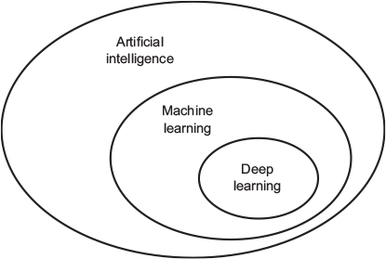
Artificial intelligence, machine learning, and deep learning
Artificial Intelligence (AI)
Involves machines that can perform tasks/job that are characteristic of human intelligence.
Might involve some machine learning
Machine Learning (ML)
Development of algorithms, which improve by presenting data
Deep Learning
Part of machine learning and AI
Deep models
Based on artificial neural networks.

Slide 6
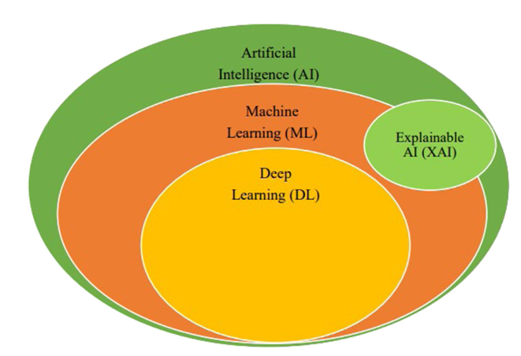
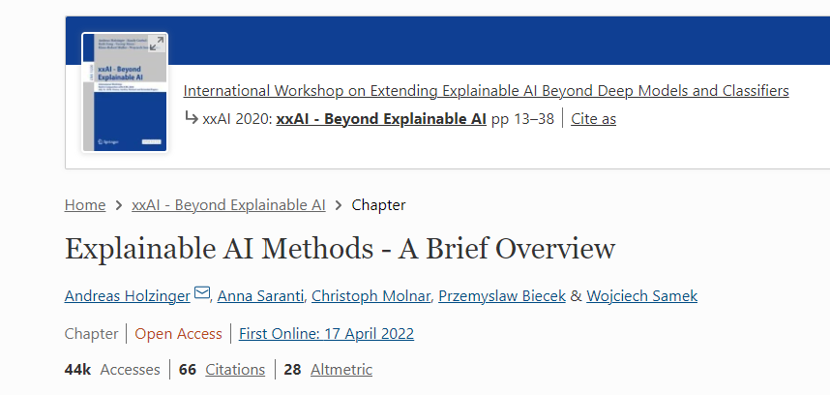
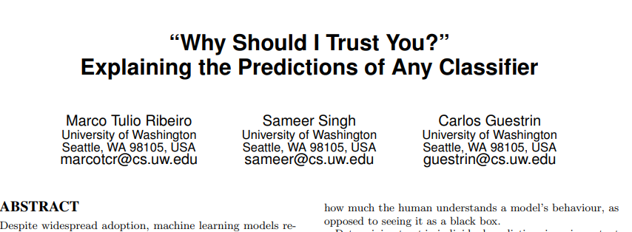
Explainable/Interpretable AI (XAI)
Why
Interpretability
The best explanation of a simple model is the model itself
It perfectly represents itself and is easy to understand.
Many different types
LIME (Local interpretable model-agnostic explanations)
DeepLIFT
Layer-Wise Relevance Propagation
Model-Specific Approximation
Linear SHAP
Low-Order SHAP
Max SHAP
Deep SHAP (DeepLIFT + Shapley values)

Slide 7
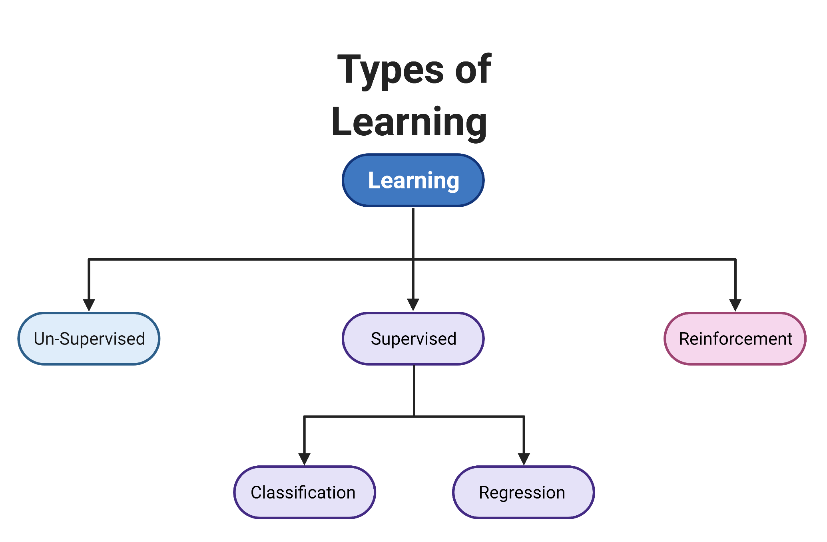
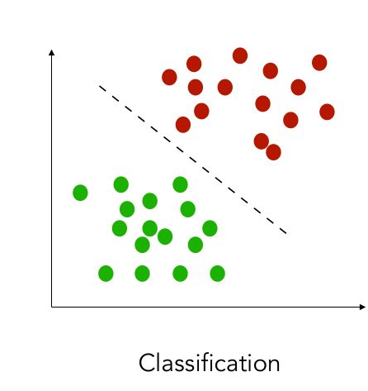
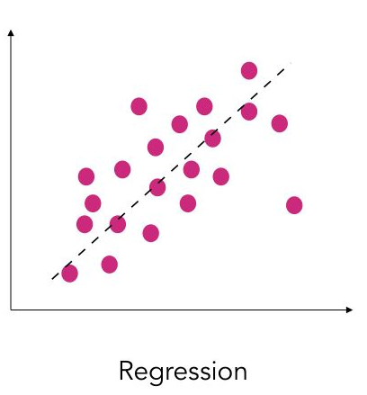
Types of learning
Unlabelled data
Labeled data
Make a sequence of decisions from complex environment

Slide 8
Algorithm
Machine learning tasks are typically classified into three broad categories
Supervised learning
The computer/algorithm is presented with example inputs and their desired outputs, given by a “teacher” (user), and the goal is to learn a general rule that maps inputs to outputs
Unsupervised learning
No labels are given to the learning algorithm, leaving it on its own to find structure in its input
Unsupervised learning can be a goal in itself (discovering hidden patterns in data)
Reinforcement learning
A computer program interacts with a dynamic environment in which it must perform a certain goal (such as driving a vehicle), without a teacher explicitly telling it whether it has come close to its goal or not

Slide 9
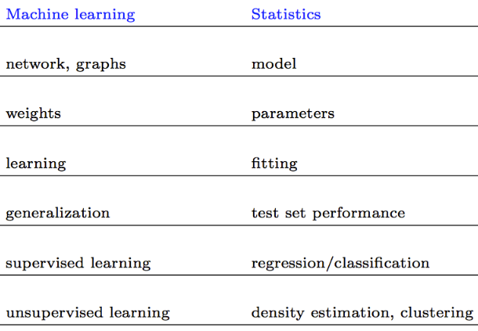
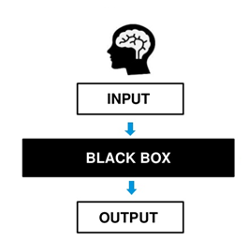
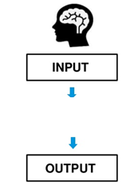
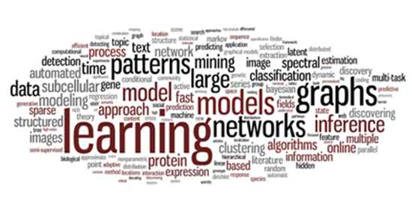
Machine learning vs. Statistics
y=α+ α₁x₁+ α₂x₂+…+ α_{n}x_{n}

Slide 10

Work Flow of Machine Learning Methods
Questions
Input Data/
Data Structure
Algorithm/
Method
Parameters / Weights
Training/Testing
Evaluation

Slide 11

Questions
Questions are usually in two categories
Observation/individual related
How observations are clustered? For example: Credit card fraud or not
Outliers
Missing values
Feature/Variable related
How variables/features are clusters?
Which variables are making differences among many classes?
Which variables are correlated ?
Is it possible to identify them in the data set?
Are those variables being predictive? Can be used as a stratification in different location?
Are those variables being stable?
Are those variables statistically significant?

Slide 12
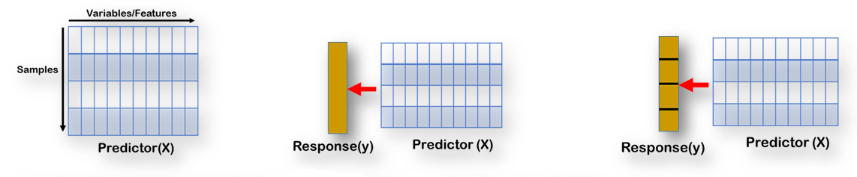
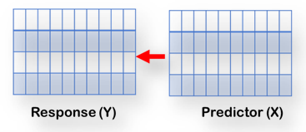
Input Data
Input data can have different structures
It is very important to understand what type of question is being asked and does data support that

Slide 13
Example: Algorithm
Supervised Learning: Classification and regression
Decision trees Ensembles
Support vector machine (SVM)
k-NN Linear regression
Naive Bayes
Neural networks
Logistic regression Perceptron
Unsupervised Learning
Hierarchical Clustering
k-means Clustering
Reinforcement Learning
Markov Decision Process

Slide 14
Parameters and hyperparameter
Each of the machine learning algorithms associated with some extra parameters
Called as hyper parameters
For example
Number of decision trees need to use in the Random Forest Model
In classical statistics view : How many components need to use in PLS-DA model ?

Slide 15
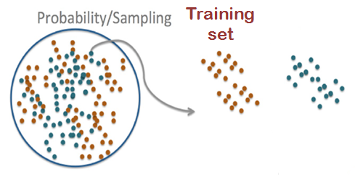
Evaluation
Test set
Class 1
Prediction Function, f(α)
Class 2
Class 3
Test set
Out of sample error /
Generalized error
Hastie et al., (2009) 2nd Ed., The Elements of Statistical Learning : Data Mining, Inference, and Prediction.

Slide 16
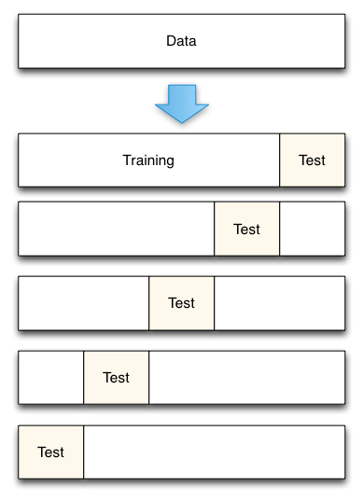
Cross Validation
How to do it?
Split the data in different parts
Keep aside test data
Build a model on training data
Evaluate on test set
Repeat
Types of Cross Validation
5 fold
10 fold
Leave one out
Resampling
Why it is used for?
Picking variables to include in the model
Picking the type of prediction function to use
Picking the parameters in the prediction function
Comparing different predictors
Depends on how many total samples are available
Some times double cross validation is recommended due to hyper parameters

Slide 17
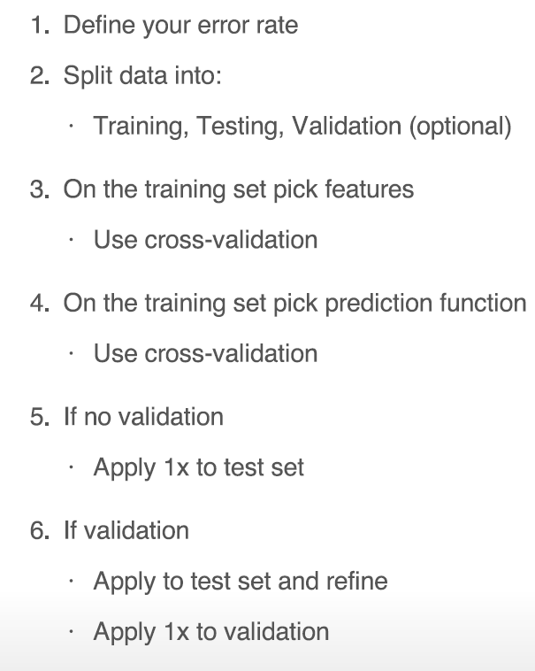
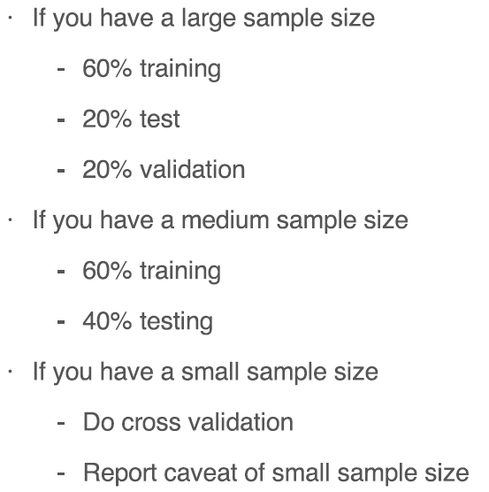
Evaluation
Prediction model design
Rule of thumb
Subjective!!!

Slide 18
Evaluating Performance
Widely used evaluation metrics for classifiers:
Accuracy is the amount of correctly classified instances of the total instances; defined as the ratio of number of correct predictions to the total number of predictions.
Confusion matrix
Confusion matrix - is a table that records the number of instances in a dataset that fall in a particular category.
Precision
Recall/sensitivity.

Slide 19
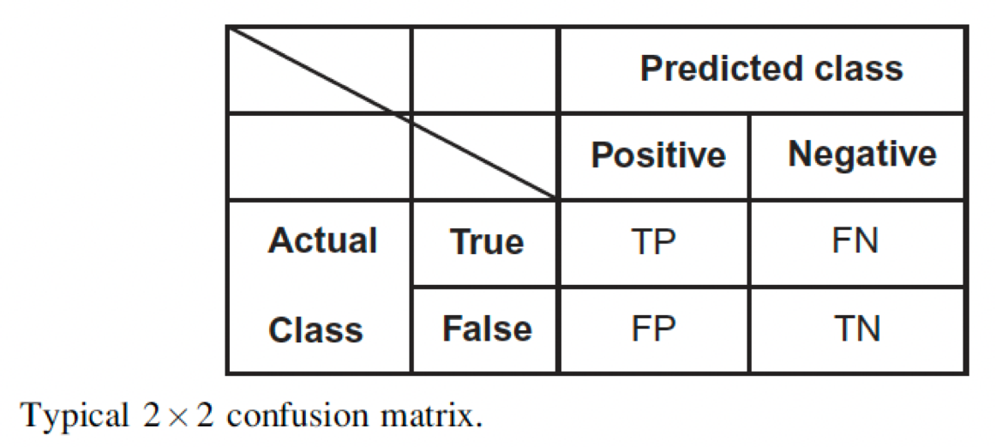


Evaluating Performance
True Positives (TP) and True Negatives (TN) are number of positive and negative instances predicted correctly.
False Positives (FP) and False Negatives(FN) are misclassified instances.

Slide 20
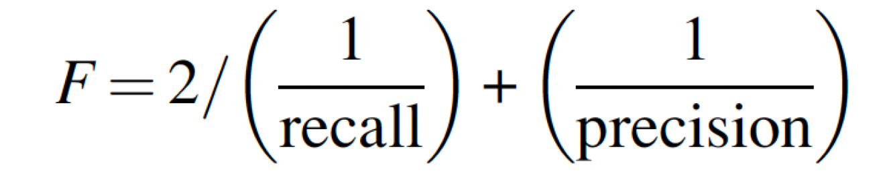
F-Measure
F-Measure- is a metric of a test’s accuracy
F measure reaches its best value at 1 (perfect precision and recall) and worst at 0.

Slide 21
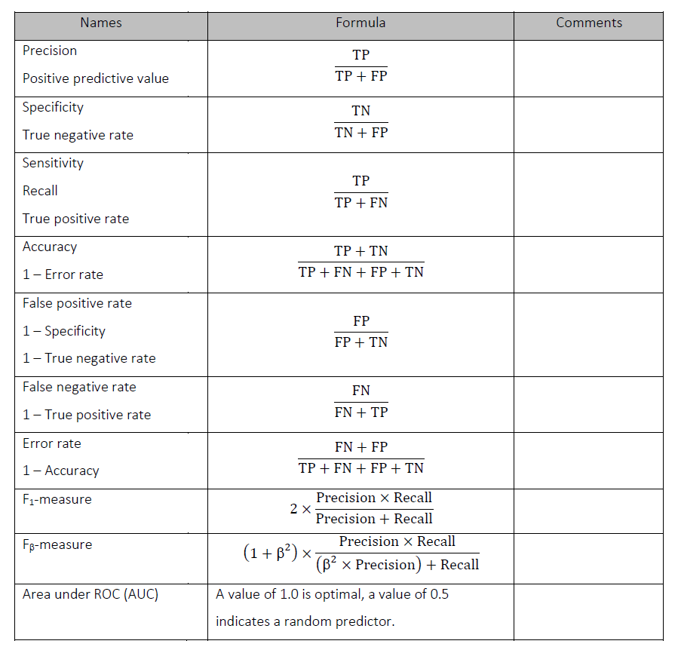
Other matrices

Slide 22
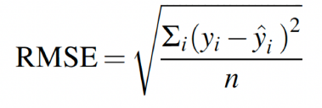
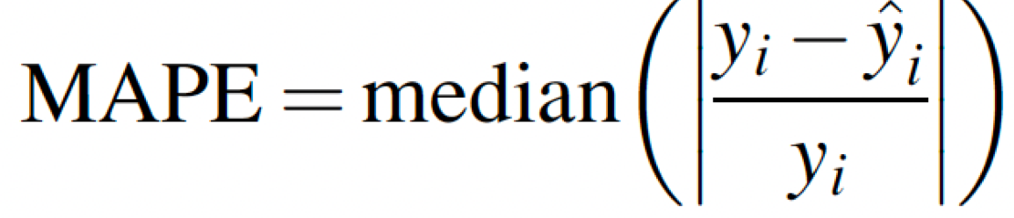
Regression matrices
RMSE is defined as the square root of the average squared distance between the actual score and the predicted score
Median Absolute Percentage Error
where y_{i} is the true value for the ith data point, y_{i}-hat is the predicted value, and n is the number of data points.

Slide 23
Regression revisit

Slide 24
Regression: One example
Here:
y = Response
x₁ = Predictor 1
β₁
y (Response) = β₀ + β₁* X₁ + Error
Slope / Coefficient/ Weights

Slide 25
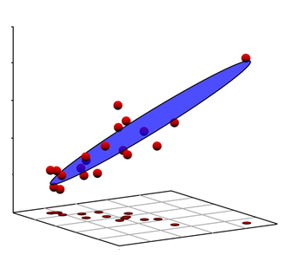
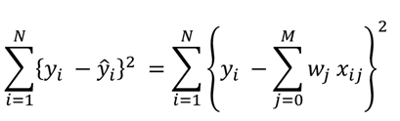
Multiple linear regression
Same example but with x₂:
y = Response
x₁ = Predictor 1
x₂ = Predictor 1
y
Regression Equation : Surface
y = β₀ + β₁* X₁+ β₂ * X₂ + Error
x₂
x₁
If nr. of variable= “p”, then
More general Equation: multidimensional surface
y = β₀ + β₁*X₁+ β₂*X₂+ β₃*X₃… + β_{p}*X_{p}+ Error
Question:
Do you see any problem / Issue in this example?
Or in closed form

Slide 26
Multicollinearity
X₁ and X₂might be correlated
Exact or near linear relationships between the x variables
Also called as : collinearity, near-collinearity or ill-conditioning
What are the consequences?
Regression coefficients
Unstable (sensitive to small changes)
Not uniquely defined
Have high variance
Coefficients can get the wrong sign
Absolute values of regression coefficients can be absurdly high
Impossible to interpret individually
Relative importance of variables cannot be estimated reliably

Slide 27
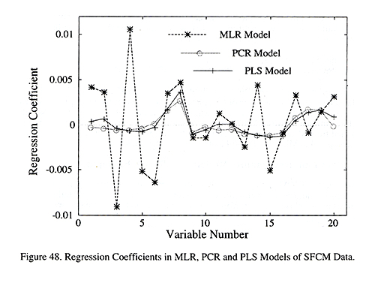
Bouncing betas
Consequences of Multicollinearity
The Elements of Statistical Learning: Data Mining, Inference, and Prediction ; Trevor Hastie, Robert Tibshirani, Jerome Friedman

Slide 28
Multicollinearity
Always occurs when
More variables (p) than objects (n) (p>n)
Therefore
Normal multiple linear regression not possible !
Traditional solutions
Collect more data
Takes lots of time, money
Sometime impossible because of logistics (Project plan)
Use a set of variables p_{subset} < n
Filter on quality criteria: ok
Still p >> n
Do not want to remove more if not known whether important

Slide 29
Also possible solutions
Use selected variables based on “some” criteria
Filter first on univariate methods (t-test, correlation, ANOVA)
Problem
Assumption is variables are independent
Multiple testing
Dimension reduction (PCA, clustering)
Machine learning methods
Penalized methods

Slide 30
Penalization / Regularaization/ Sparse/ Shrinkage methods Lasso, Ridge and Elastic Net

Slide 31
Recollect: Multiple linear regression
Same example but with x₂:
y = Response
x₁ = Predictor 1
x₂ = Predictor 1
y
Regression Equation : Surface
y = β₀ + β₁* X₁+ β₂ * X₂ + Error
x₂
x₁
If nr. of variable= “p”, then
More general Equation: multidimensional surface
y = β₀ + β₁*X₁+ β₂*X₂+ β₃*X₃… + β_{p}*X_{p}+ Error
Question:
Do you see any problem / Issue in this example?
Or in closed form

Slide 32
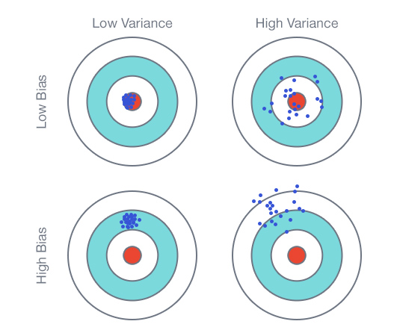
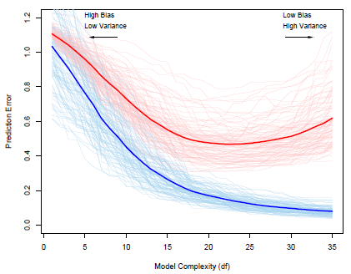
Bias, Variance and Model Complexity
Model Complexity = Bias + Variance
Hastie et al.(2009), The Elements of Statistical Learning: Data Mining, Inference, and Prediction

Slide 33
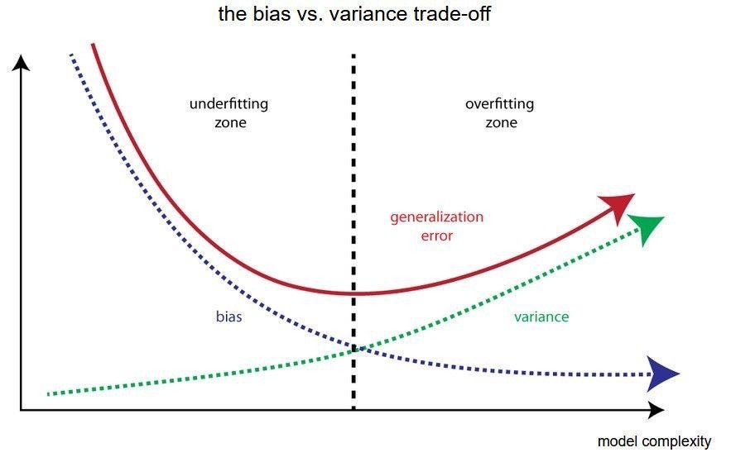
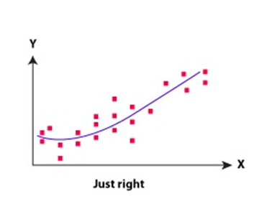
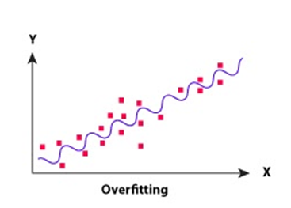
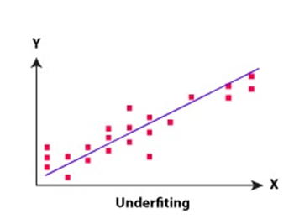
A line that captures every single point in the graph
A line that captures a general direction but does not capture many of the points.
A line that captures the general direction of the points but might not capture every point in the graph

Slide 34
Why is regularization important?
Regularization favours simpler models to more complex models to prevent your model from overfitting to the data.
How so?
They address the following concerns within a model:
Variance-bias trade-off
Multicollinearity
Sparse data handling(i.e. the situation where there are more observations than features)
Feature selection
An easier interpretation of the output.

Slide 35

Type of methods
Penalization Methods
Variable Selection Methods
LASSO (Tibshirani R, 1996)
Elastic Net (Zou H, 2005)
Ranking Methods
Ridge (Hoerl and Kennard, 1970)
LASSO (Tibshirani R, 1996)
Fused LASSO (Tibshirani and Saunders, 2005)
Grouped LASSO (Yuan M, 2006)
Adaptive LASSO (Zou H, 2006)
Graphical LASSO (Friedman et al., 2007)

Slide 36
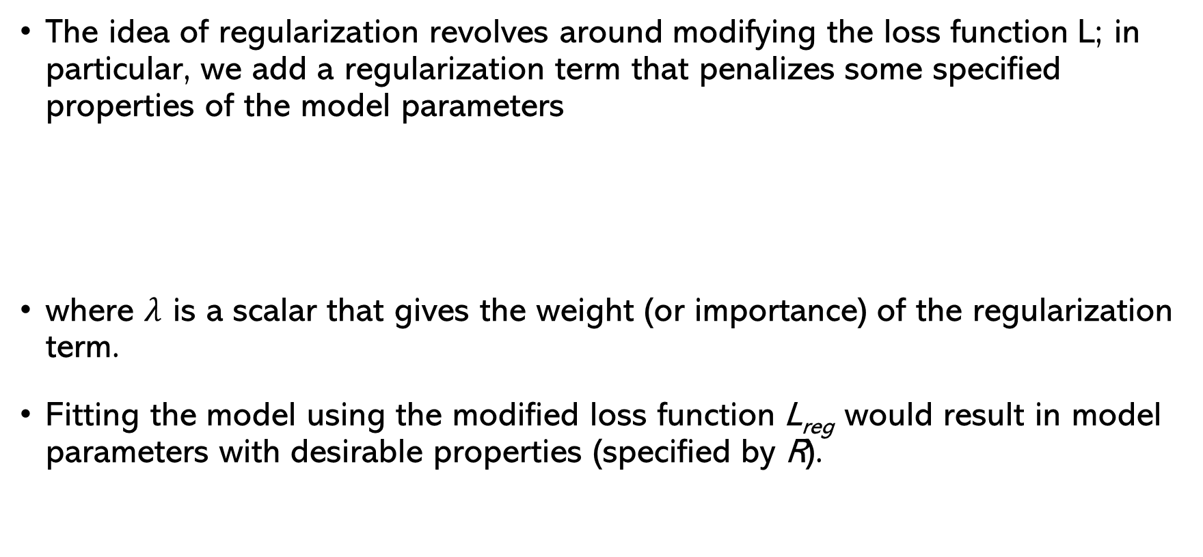
Regularization: An Overview
The idea of regularization revolves around modifying the loss function L; in particular, we add a regularization term that penalizes some specified properties of the model parameters
where $λ$ is a scalar that gives the weight (or importance) of the regularization term.
Fitting the model using the modified loss function L_{reg} would result in model parameters with desirable properties (specified by R).

Slide 37
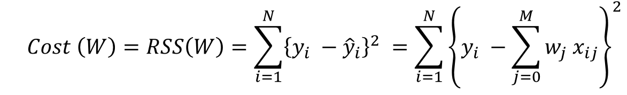
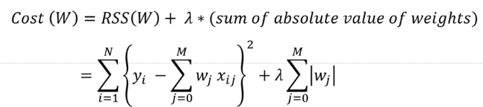
Introduction to LASSO
Recollect least squares for OLS
The OLS equation is also called as objective function/cost function
The residual sum of squares(RSS) plus the sum of absolute value is minimized
LASSO stands for Least Absolute Shrinkage and Selection Operator
LASSO regression performs L1 regularization, i.e. it adds a factor of sum of absolute value of coefficients in the optimization objective.

Slide 38
Properties of LASSO
LASSO (Least Absolute Shrinkage and Selection Operator)
Variable will be selected, depending on λ
λ is called as penalty parameter/ Shrinkage parameter
The value of λ lies between 0 to 1
λ close to 1 means
Heavy penalization
Less variables will be selected
Many variables shrunk to “0” (kicked out from model)
Automatic variable/feature selection !
No grouping of correlated variables
Maximum of “n” variables selected
Bottle neck : Selection of “λ”
Should be estimated from data (Unbiased way)

Slide 39
Ridge Regression
Alternatively, we can choose a regularization term that penalizes the squares of the parameter magnitudes. Then, our regularized loss function is:
Note that is the square of the l₂ norm of the vector β

Slide 40
Choosing λ
In both ridge and LASSO regression, we see that the larger our choice of the regularization parameter λ, the more heavily we penalize large values in β,
If λ is close to zero, we recover the MSE, i.e. ridge and LASSO regression is just ordinary regression.
If λ is sufficiently large, the MSE term in the regularized loss function will be insignificant and the regularization term will force β_{ridge} and β_{LASSO} to be close to zero.
To avoid ad-hoc choices, we should select λ using cross-validation.

Slide 41
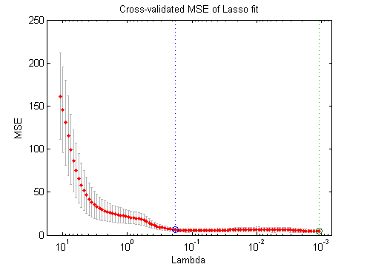
Selection of “λ”
Very critical
Can be optimised
Linear optimization
Nonlinear optimization
The solution of the Ridge/Lasso regression involves three steps:
Select λ
Find the minimum of the ridge/Lasso regression loss function and record the MSE on the validation set.
Find the λ that gives the smallest MSE
MSE
(Mean Square Error)
“λ” (lambda)

Slide 42
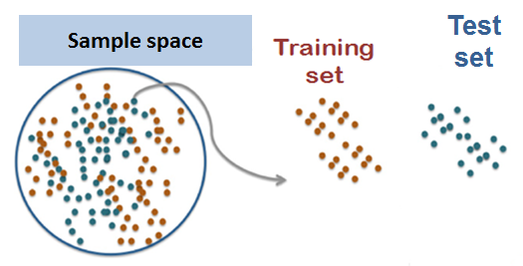
Evaluation
Prediction Function, f(α)
Out of sample error/
Generalized error/MSE
Test set

Slide 43
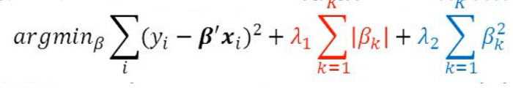
Elastic Net Regression
LASSO
Ridge
Elastic Net produces a regression model that is penalized with both the L1-norm and L2-norm.
The consequence of this is to effectively shrink coefficients (like in ridge regression) and to set some coefficients to zero (as in LASSO).

Slide 44
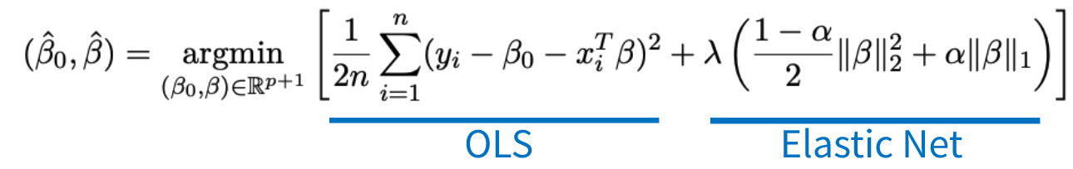
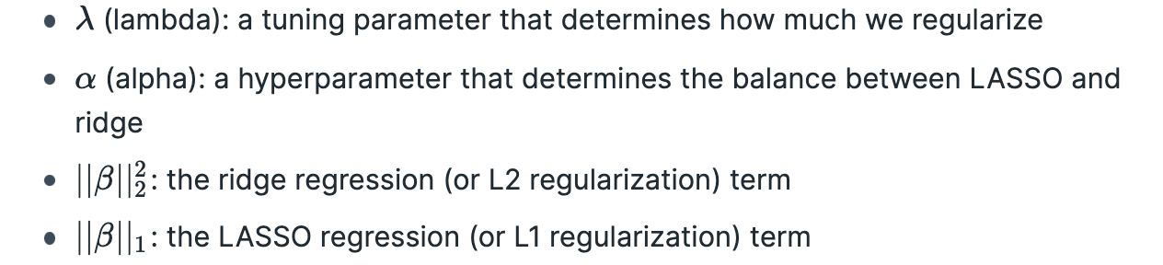
Elastic Net Regression

Slide 45
Elastic Net Regression
The elastic net method performs variable selection and regularization simultaneously.
Groupings and variables selection are the key roles of the elastic net technique.
The elastic net technique is most appropriate where the dimensional data is greater than the number of samples used.

